Slide 1
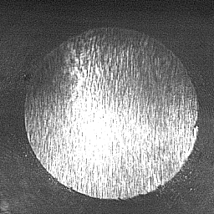
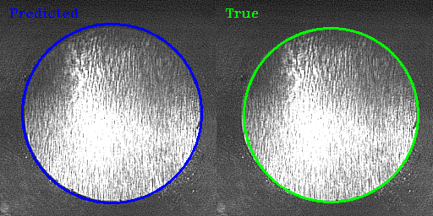





Output : (x,y), r
Initialization : HeNormal
labels : (x,y), r

